Slide 1
PROJECT REPORT
1 INTRODUCTION
Fresh Bites Catering is a renowned catering service known for its commitment to providing high-quality, delicious food for a wide range of events and occasions. With a focus on using fresh, locally-sourced ingredients, they offer a diverse menu that can be tailored to suit various dietary preferences and needs. Whether it's a corporate function, wedding, or private gathering, Fresh Bites Catering prides itself on delivering exceptional culinary experiences with impeccable service. Their team of experienced chefs and staff work closely with clients to create memorable dining experiences that leave a lasting impression.

Slide 2
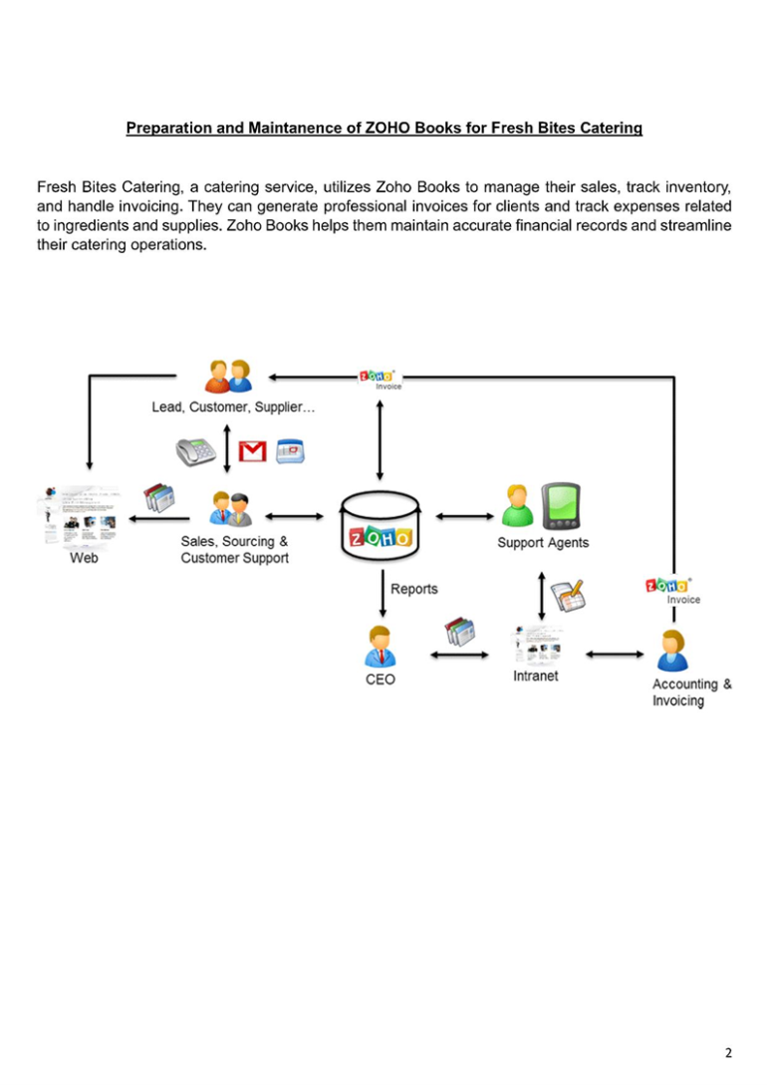
Preparation and maintainance of zoho books fresh bites catering

Slide 3
PROBLEM DEFINITION & DESIGN THINKING
It is created method of preparation of Accounting profit and loss account , balance Sheet and GST calculation is completed.
In recent day’s new technologies allotted. Here we use Zohobook as a tool for creating Profit and loss account, balance sheet and GST report.
2.1 Empathy Map
2.2 Ideation & Brainstroming Map

Slide 4
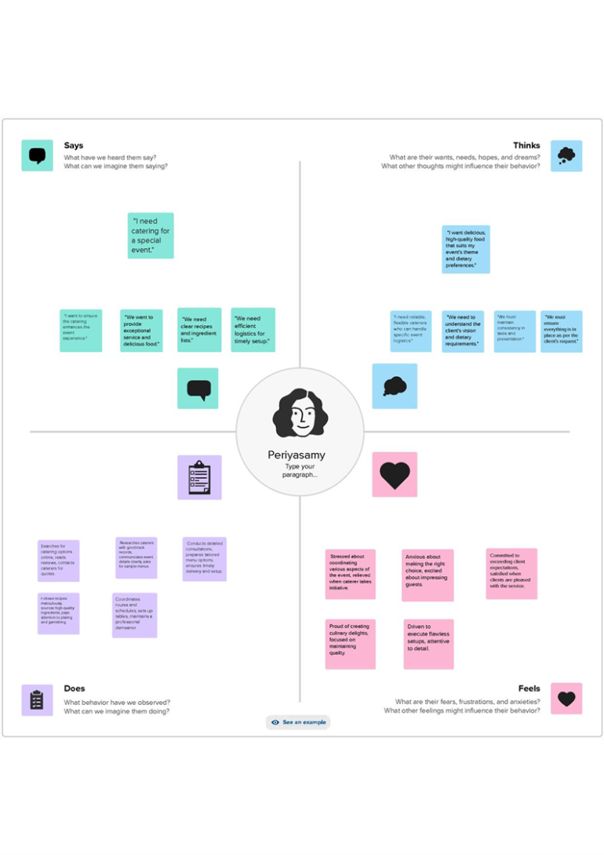
Empathy map

Slide 5
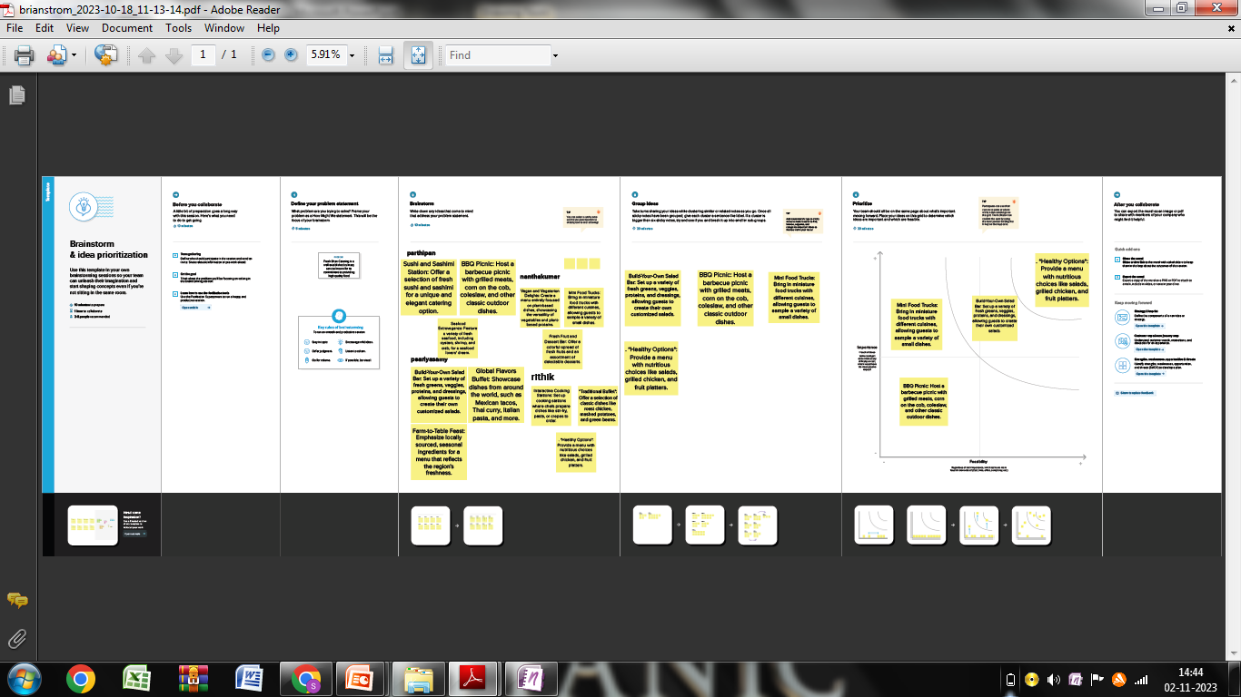
RESULT Output: 1.Company Name Creation:

Slide 6
We have to create our Company Name And other Details From Below Zohobooks
2. Item Creation: We have to create items, Such as
➢ Item names
➢ Units
➢ HSN/SAC
➢ Selling info/Purchase info
➢ Tax Rate

Slide 7
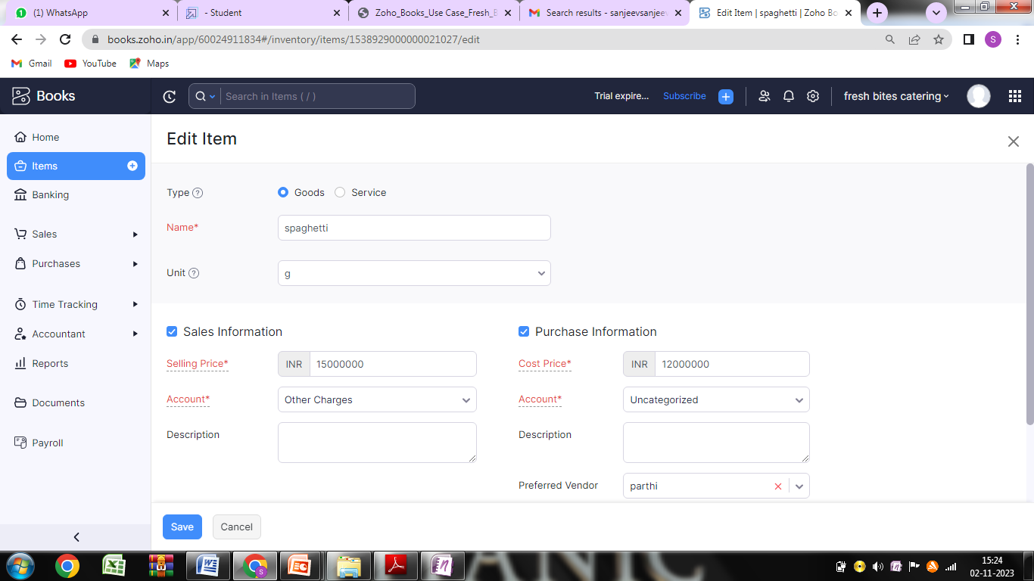
Item Creation

Slide 8
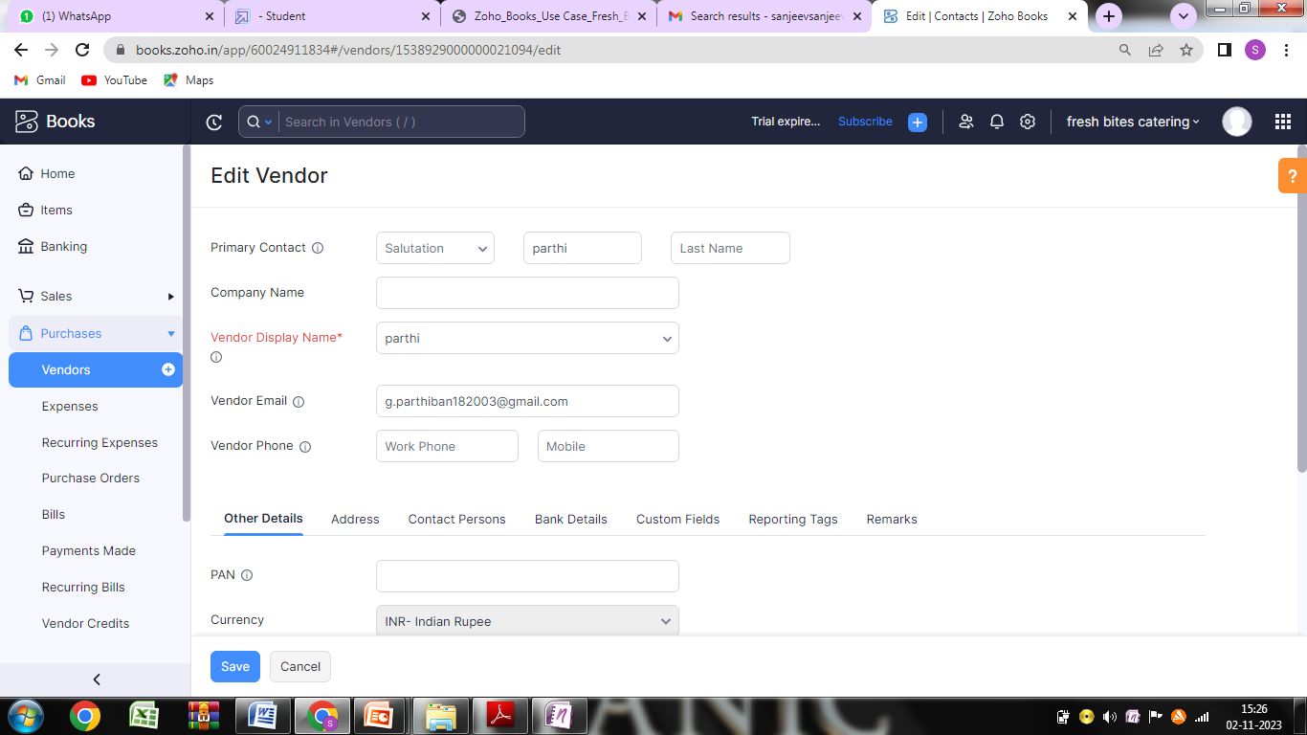
3. Vendor Creation: Now create Vendor in books from navigator panel Create New Vendor For example

Slide 9
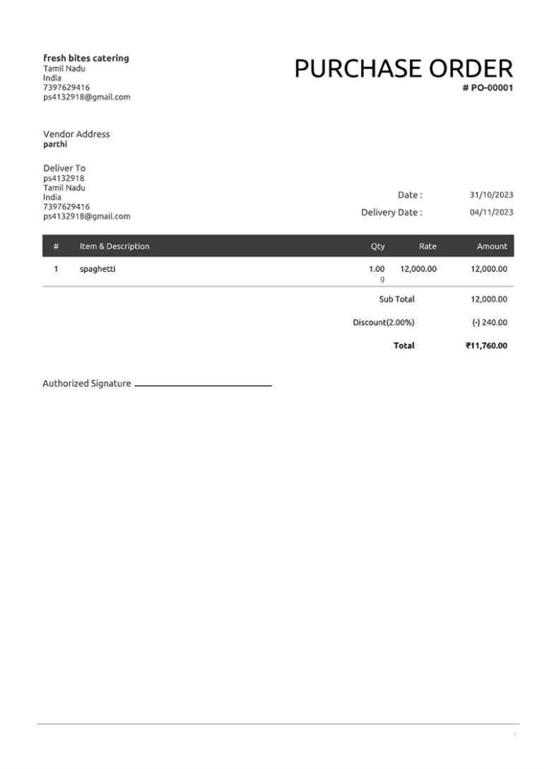
4. Purchase Order: We are creating new purchase order such as below

Slide 10
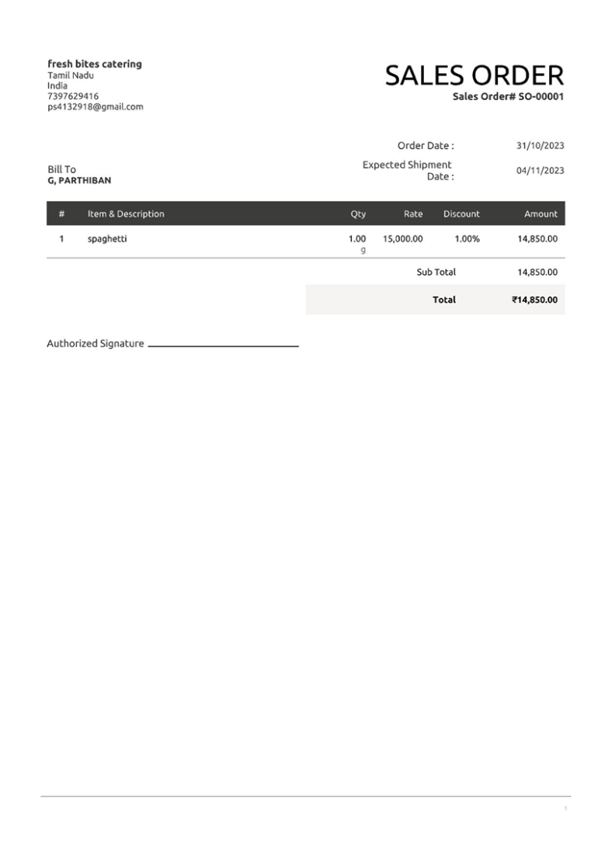
Sales order

Slide 11
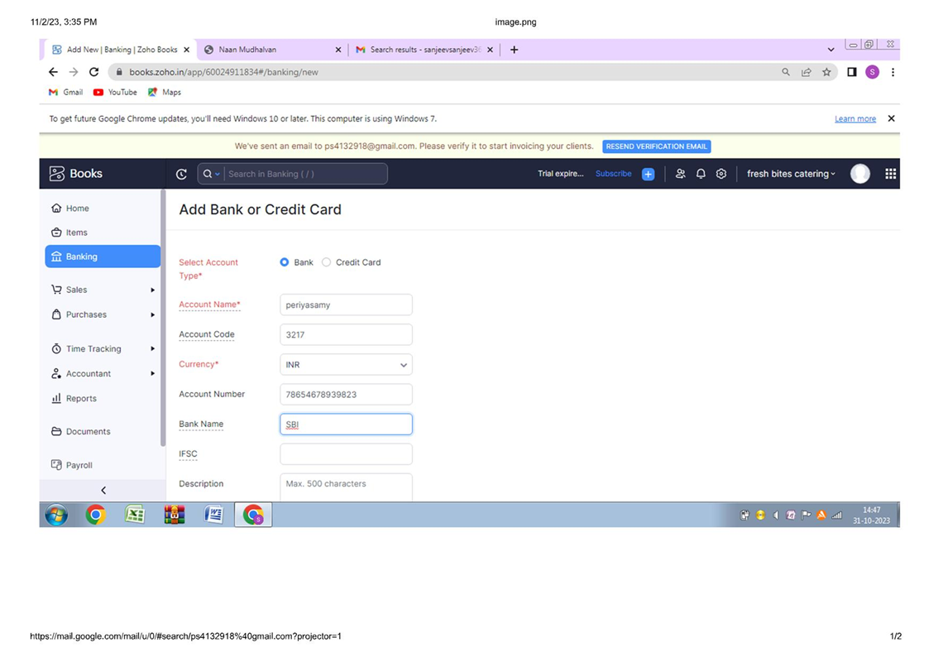
6.Payment to Bank Details: spaghetti has opened an account with ICICI bank, to add the bank account And we have to select bank account manually and filled it.

Slide 12
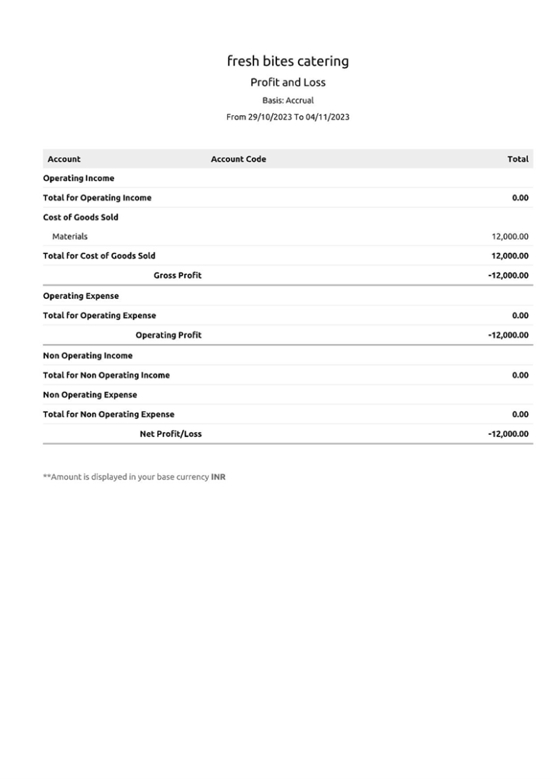
7. Profit and loss Account\ Balance Sheet\GST Report :

Slide 13
4 ADVANTAGE & DISADANTAGE: ADVANTAGE: Easy for Managing day to day activities. DISADVANTAGE: Missing New Version. 5 APPLICATION: This application used to maintain the company details and ledger accounts, profit and loss Account and Balance sheet of the dream homes realty.
6 CONCLUSION:
Fresh Bites Catering provides a delightful culinary experience, combining exceptional flavors with impeccable service. With a diverse menu and a commitment to using fresh, high-quality ingredients, they consistently deliver a memorable dining experience. From casual gatherings to formal events, Fresh Bites Catering sets a standard of excellence that leaves clients and guests alike with a lasting impression. With their passion for food and dedication to customer satisfaction, Fresh Bites Catering is a top choice for any occasion.

Slide 14
7 FUTURE SCOPE:
The future of Fresh Bites Catering holds promising opportunities for growth and innovation. With a strong foundation in providing high-quality catering services, they have the potential to expand their offerings, potentially venturing into new markets or exploring niche segments. Embracing sustainable practices and incorporating technology could also play a pivotal role in their evolution. Moreover, collaborations with local producers or farms could further enhance their commitment to using fresh, locally-sourced ingredients. By staying attuned to culinary trends and customer preferences, Fresh Bites Catering is well-positioned to continue thriving in the dynamic catering industry.
8 APPENDIX:
➢ Approved development
➢ Future Assessment
➢ Plan of development
➢ Development Purpose
➢ Interpretation

